Slide 1




CENTRO DE EXCELENCIA EN INVESTIGACION
LABORATORIO GENOMICO
ALIENZA ESTRATEGICA INTER
INSTITUCIONAL
UNIVERSIDAD DE WISCONSIN-MADISON
UNIVERSIDAD NACIONAL DE COLOMBIA
CORPORACION RUTA N

Slide 2

Towards a machine learning-based approach to forecasting Dengue virus outbreaks in Colombian cities. A case-study: Medellín, Antioquia
Alberto M. Ceballos- Arroyo, Daniel O. Maldonado-Perez, Hugo Mesa-Yepes, Jorge E. Osorio-Benítez, Juan P. Hernández- Ortiz, John W. Branch-Bedoya
Colombia/Wisconsin one Health Consortium, Universidad Nacional de Colombia, Medellín, Colombia.
Departamento de Ciencias de la Computación y de la Decisión, Grupo de I+D en Inteligencia Artificial, Universidad Nacional de Colombia, Medellín, Colombia
Department of Pathobiological Sciences, University of Wisconsin – Madison, United States
E-mails: alceballosa@unal.edu.co, domaldonadop@unal.edu.co, jphernandezo@wisc.edu, jwbranch@unal.edu.co

Slide 3
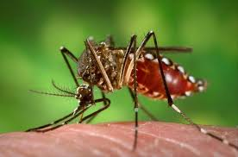
Dengue disease
Dengue is a disease which is mainly transmitted by the female of the Aedes aegypti mosquito. This disease manifests itself such as fever, headaches, severe joint and muscle pain, skin rash and is most prevalent in tropical and sub-tropical regions where demographic and climatic conditions aid the propagation of the vector and the disease, resulting in many cases per year.
Figure 1. Aedes aegypti.

Slide 4
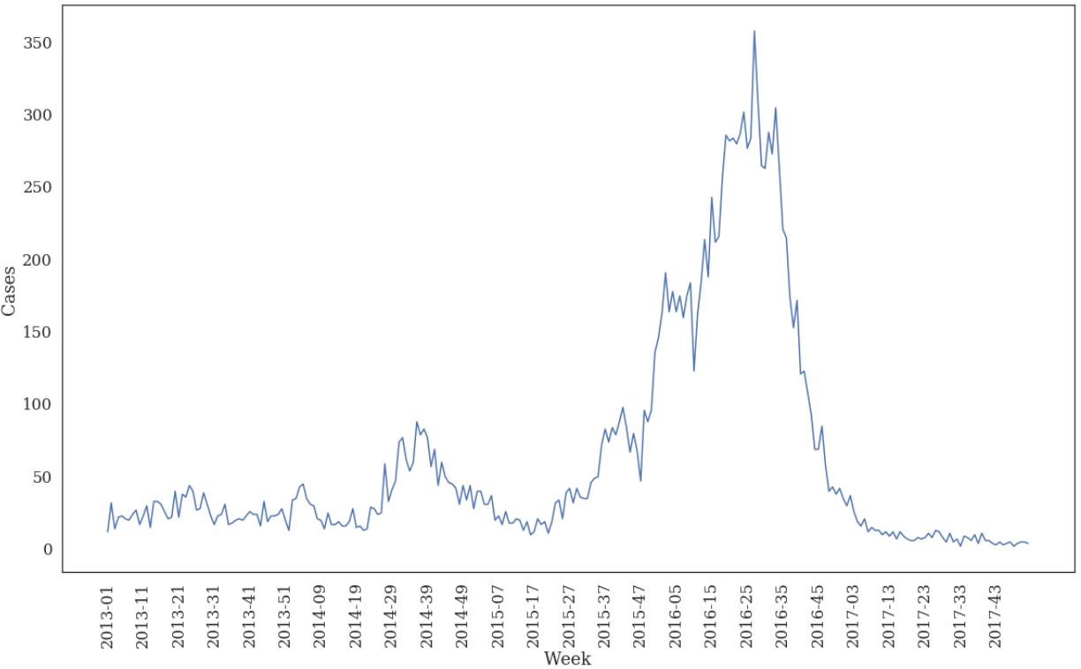
Dengue disease
Medellín is a hyper-endemic city for the dengue virus, as the four dengue serotypes are present in it and all of them can infect humans (Parra et al., 2018).
Figure 2. Confirmed dengue cases per week in Medellın from 2013 to 2017. Source: SIVIGILA.

Slide 5
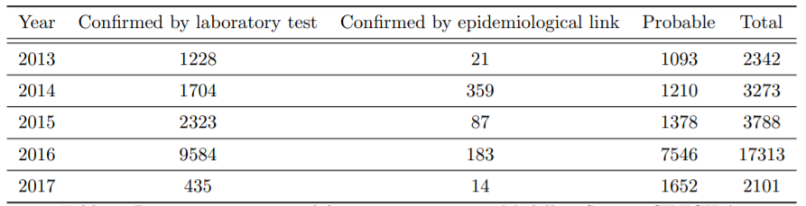
Dengue data
The data employed in this study was extracted from the dengue fever cases reported in the System for Surveillance in Public Health (SIVIGILA) from years 2013 to 2017 in the city of Medellin.
Table 1. Dengue cases reported from 2013 to 2017 in Medellin. Source: SIVIGILA

Slide 6

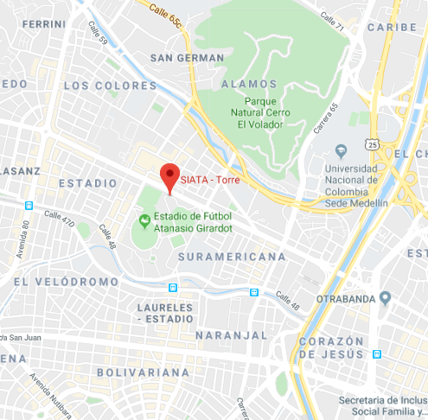
Meteorological Data
Climate data was obtained through the Early Warning System for Medellin and the Aburrá Valley (SIATA).
We used measurements gathered by sensors in the SIATA Tower station:
Precipitation
Temperature
Relative humidity
Figure 3. SIATA tower.

Slide 7
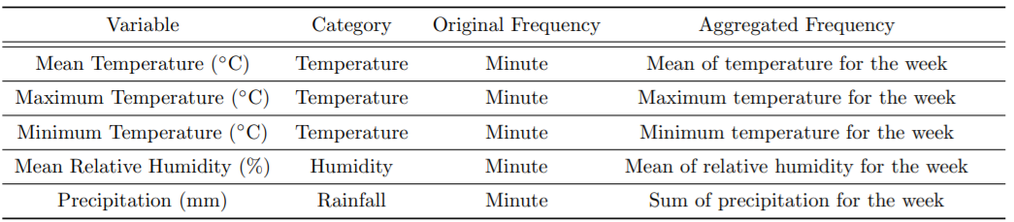
Meteorological Data: Variables
Table 2. Weather and Climate parameters. Source: SIATA

Slide 8
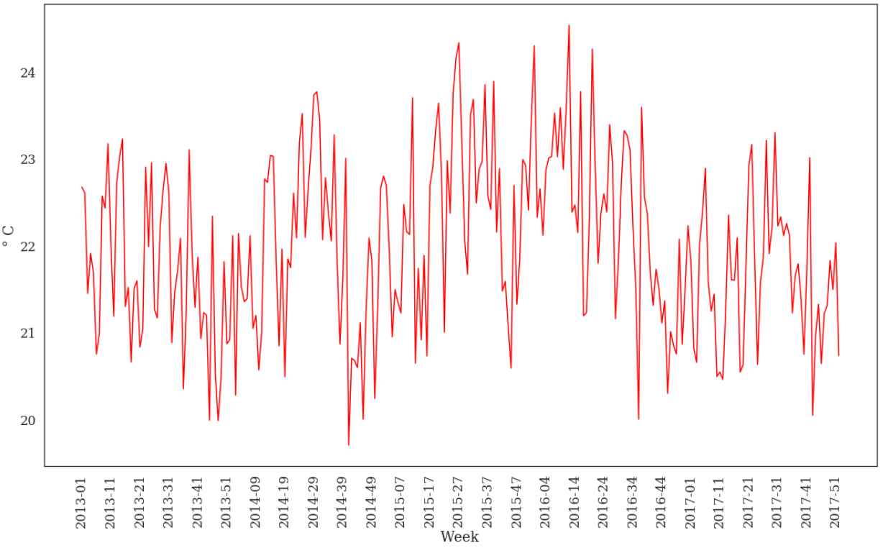
Meteorological Data: Temperature
Figure 4. Mean weekly temperature for Medellin, from 2013 to 2017. Source: SIATA.

Slide 9
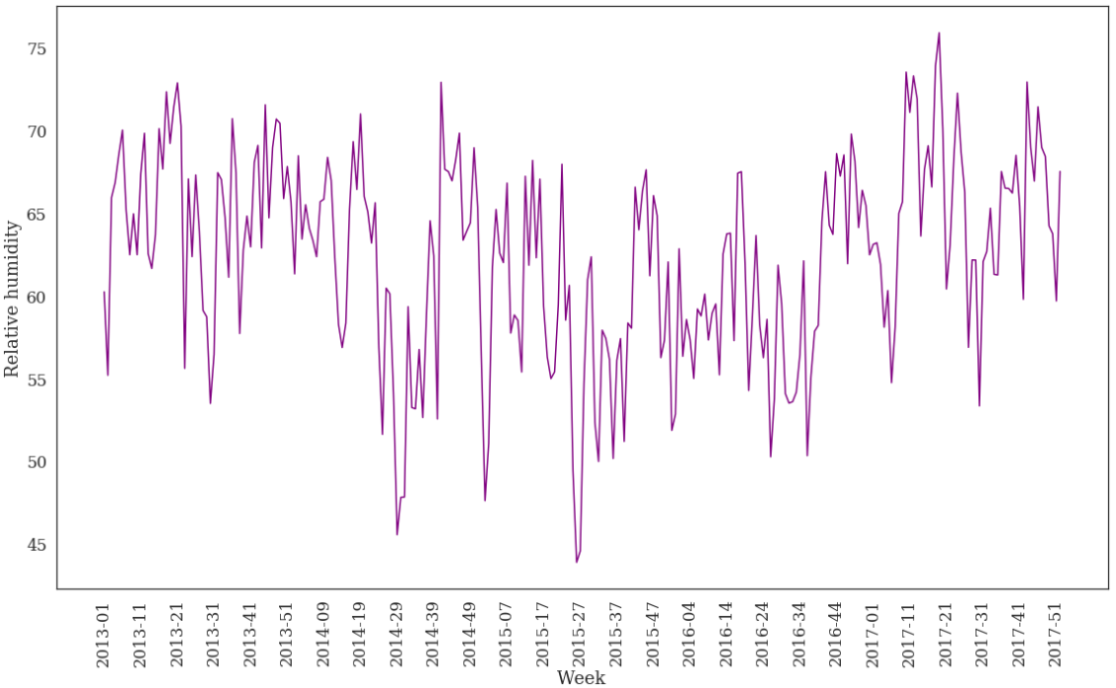
Meteorological Data: Relative Humidity
Figure 5. Mean weekly relative humidity for Medellin, from 2013 to 2017. Source: SIATA.

Slide 10
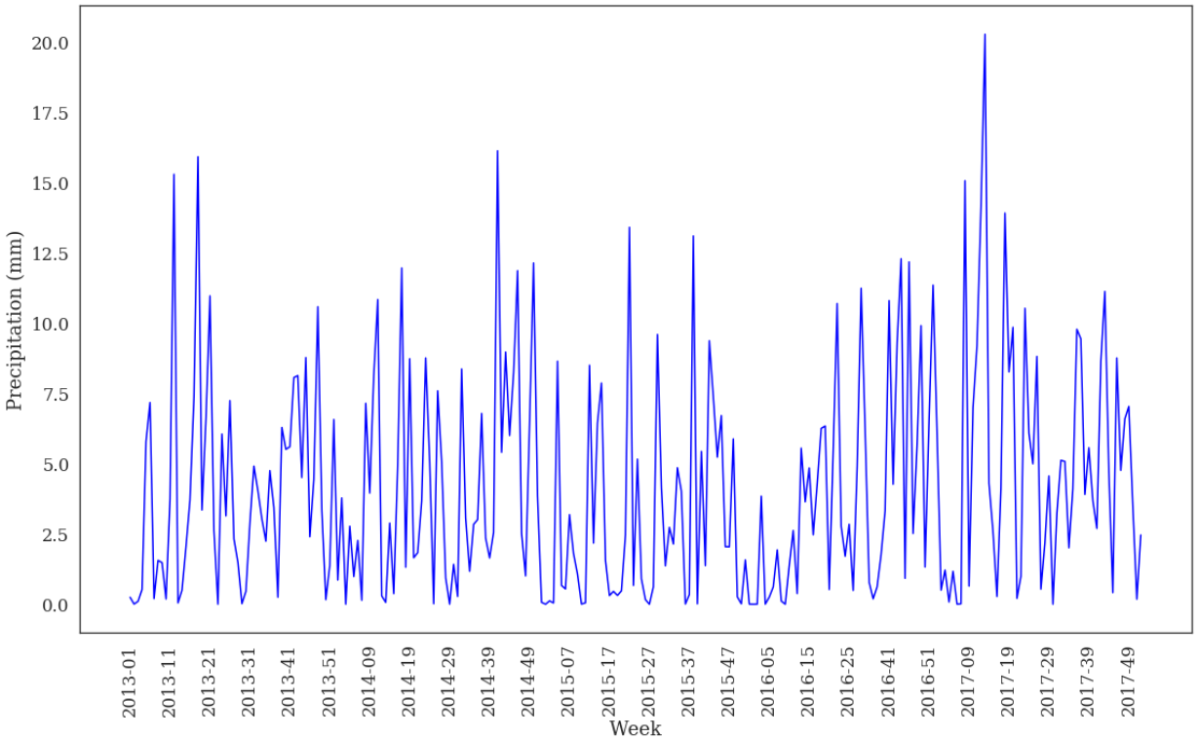
Meteorological Data: Precipitation
Figure 6. Weekly precipitation for Medellin, from 2013 to 2017. Source: SIATA.

Slide 11
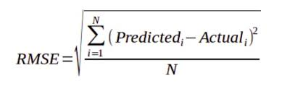
Methodology
The data was aggregated on a weekly basis and several datasets were prepared. In this presentation, we show tests on two of them. Model performance was measured using the Root Mean Squared Error metric.
All of the climate variables, the number of the epidemiological week and confirmed dengue cases only.
All of the climate variables, the number of the epidemiological week and confirmed + probable dengue cases.

Slide 12
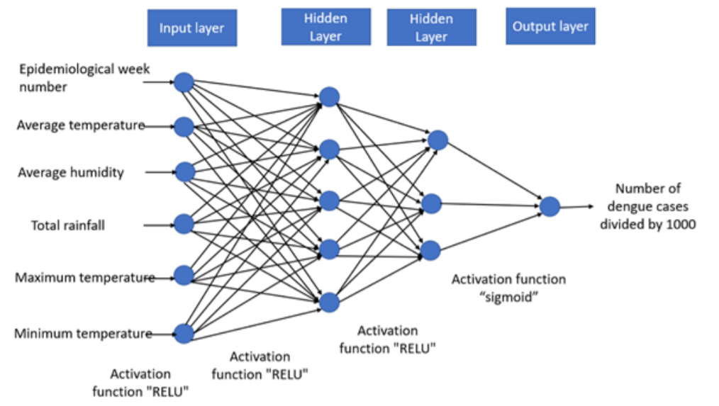
Forecasting Model
We propose a multilayer perceptron with two hidden layers with RELU activation functions and a sigmoid function for the output layer. Network performance was measured with the Root Mean Squared Error:
Figure 6. Structure of the proposed neural network.

Slide 13
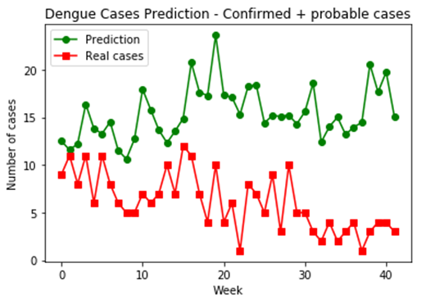
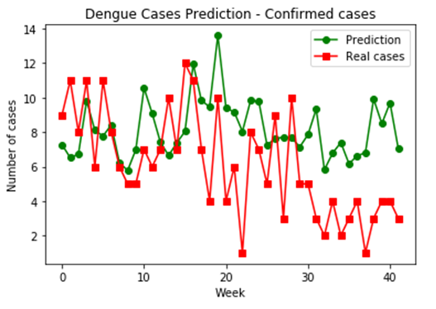
Results
a. RMSE: 0.00958
b. RMSE: 0.00671
Figure 7 . Neural network performance on a validation subset of 41 weeks: a) confirmed and probable, b) confirmed cases only.

Slide 14
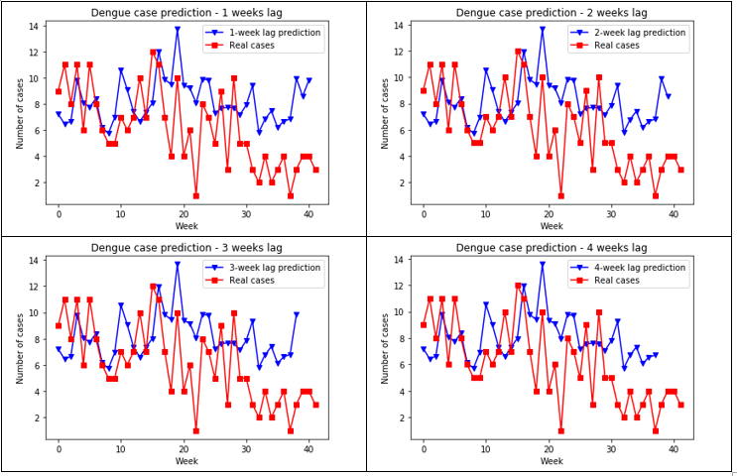
Results
Figure 8. MLP performance for several lag values.

Slide 15
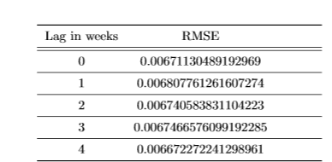
Results
Table 3. Network performance for several lag values.

Slide 16
Conclusions
ANN-based forecasting for time series shows a trend for correct forecasts for the first weeks of the validation data, with a deterioration in precision as we tried to forecast dengue cases for further weeks.
Using confirmed data only is preferable, since probable cases often contain “noise” in the form of miss-labeled cases of other diseases such as zika and chikungunya.
Albeit the available data was enough for producing a good fit, it is clear that the limited amount of data has an impact on the kind of patterns the network can discover.

Slide 17
Future work
We suggest using recurrent neural networks for better modeling the temporal dependencies between the variables.
It is important to identify other types of variables which could be incorporated into the model, as well as new variables based on existing data.
More granularity in forecasting could be attained with daily reports. However, SIVIGILA only produces weekly reports. This can be addressed by using data from fever clinics in several Colombian cities, which can generate confirmed dengue case data with a daily frequency.

Slide 18
References
Parra, B., Rengifo, G., Mendez, F., Burbano, M. E., Arias, J. F., Muñoz, J., and Barreto, M., “Human and Mosquito Infections By Dengue Viruses During and After Epidemics in a Dengue–Endemic Region of Colombia,” The American Journal of Tropical Medicine and Hygiene 74(4), 678–683 (2018).
Peña-García, V. H. and Triana-Chávez, O., “Estimating Effects of Temperature on Dengue Transmission in Colombian Cities,” Annals of Global Health 83(3-4), 509–518 (2017).
Ortiz, C., Rúa-Uribe, G. L., and Rojas, C. A., “Conocimientos , prácticas y aspectos entomológicos del dengue en Medellín , Colombia : un estudio comparativo entre barrios con alta y baja incidencia,” (2018).
Arboleda, S., Jaramillo, N., and Peterson, A. T., “Spatial and temporal dynamics of Aedes aegypti larval sites in Bello , Colombia,” 37(1), 37–48 (2011).
Arboleda, S., Jaramillo-o, N., and Peterson, A. T., “Mapping Environmental Dimensions of Dengue Fever Transmission Risk in the Aburr´a Valley , Colombia,” 3040–3055 (2009).
Aburas, H. M., Cetiner, B. G., and Sari, M., “Dengue confirmed-cases prediction : A neural network model,” Expert Systems With Applications 37(6), 4256–4260 (2010).

Slide 19
References
Lowe, R., Bailey, T. C., Stephenson, D. B., Jupp, T. E., Graham, R. J., Barcellos, C., and Carvalho, M. S., “The development of an early warning system for climate-sensitive disease risk with a focus on dengue epidemics in Southeast Brazil,” Statistics in Medicine 32(5), 864–883 (2013).
Lee, J. S., Carabali, M., Lim, J. K., Herrera, V. M., Park, I. Y., Villar, L., and Farlow, A., “Early warning signal for dengue outbreaks and identification of high risk areas for dengue fever in Colombia using climate and non-climate datasets,” BMC Infectious Diseases 17(1), 1–11 (2017).
Guo, P., Liu, T., Zhang, Q., Wang, L., Xiao, J., Zhang, Q., Luo, G., Li, Z., He, J., Zhang, Y., and Ma, W., “Developing a dengue forecast model using machine learning: A case study in China,” PLoS Neglected Tropical Diseases 11(10), 1–22 (2017).
Ughelli, V., Lisnichuk, Y., Paciello, J., and Pane, J., “Prediction of Dengue Cases in Paraguay Using Artificial Neural Networks,” in [Int’l Conf. Health Informatics and Medical Systems 2017], 130–136, CSREA Press, Las Vegas, NV, USA (2017).
Laureano-Rosario, A., Duncan, A., Mendez-Lazaro, P., Garcia-Rejon, J., Gomez-Carro, S., Farfan-Ale, J., Savic, D., and Muller-Karger, F., “Application of Artificial Neural Networks for Dengue Fever Outbreak Predictions in the Northwest Coast of Yucatan, Mexico and San Juan, Puerto Rico,” Tropical Medicine and Infectious Disease 3(1), 5 (2018).

Slide 20
References
Alcald´ıa de Medell´ın, “SIATA.” available at https://siata.gov.co/. 3
“Portal Web SIVIGILA.” available at http://portalsivigila.ins.gov.co/sivigila/index.php.
Schmidhuber, J., “Deep Learning in neural networks: An overview,” Neural Networks 61, 85–117 (2015).
Gamboa, J. C. B., “Deep Learning for Time-Series Analysis,” CoRR (2017).
[16] Kriesel, D., “A brief introduction to neural networks.” available at http://www.dkriesel.com (2007).
Nielsen, M. A., [Neural Networks and Deep Learning], Determination Press (2015).

Slide 21


ACKNOWLEDGEMENTS
This work is supported by COLCIENCIAS under the grant No. 110-180-764-196 with funds from “El patrimonio autónomo Fondo Nacional de financiamiento para la ciencia, la tecnología y la innovación Francisco José de Caldas” within the “Programa Nacional de Ciencia, Tecnología e Innovación en Salud”.
The authors also thank InBios International and Ruta N for their financial support through the Colombia/Wisconsin One-Health Consortium.

